Slide 1
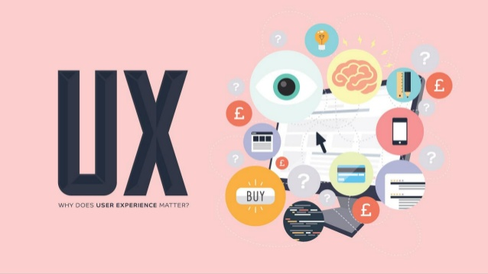

Slide 2
Objectives
What is UX Design?
The History of UX.
UX Design Disciplines: The Quadrant Model.
UX Design Tools and Projects.
The Value of UX Design.
How to Become a UX Designer.

Slide 3
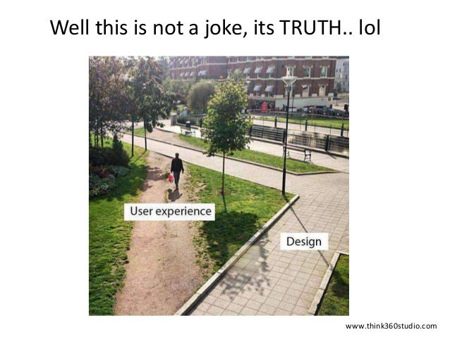
1. What Is UX Design?
The official definition of User Experience (UX) is:
“A person’s perceptions and responses resulting from the use and/or anticipated use of a product, system or service.” (ISO 9241-210:2010, subsection 2.15)

Slide 4
Cont. What Is UX Design?
“User experience encompasses all aspects of the end-user’s interaction with the company, its services, and its products.”
— Don Norman, Cognitive Scientist & User Experience Architect

Slide 5
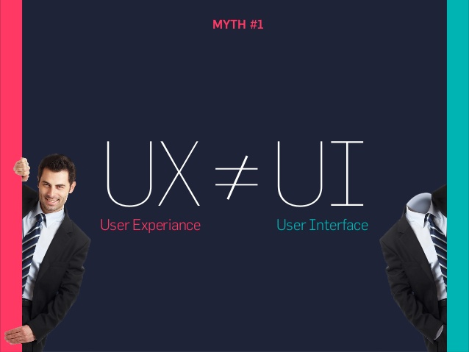
The Difference Between UX And UI Design
“UX is focused on the user’s journey to solve a problem; UI is focused on how a product’s surfaces look and function.”
— Ken Norton, Partner at Google Ventures, Ex-Product Manager at Google

Slide 6
Cont. The Difference Between UX And UI Design
User interface design is not the same as UX. UI refers to the actual interface of a product; the visual design of the screens a user navigates through when using a mobile app, or the buttons they click when browsing a website.
UX and UI go hand-in-hand, and the design of the product interface has a huge impact on the overall user experience.

Slide 7
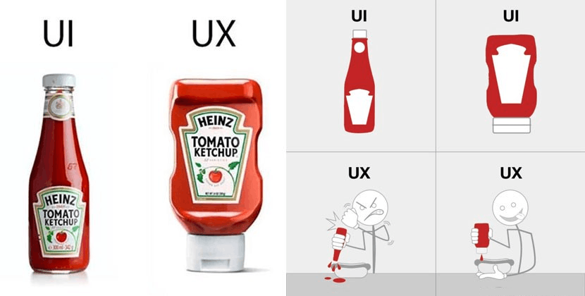
Example 1

Slide 8
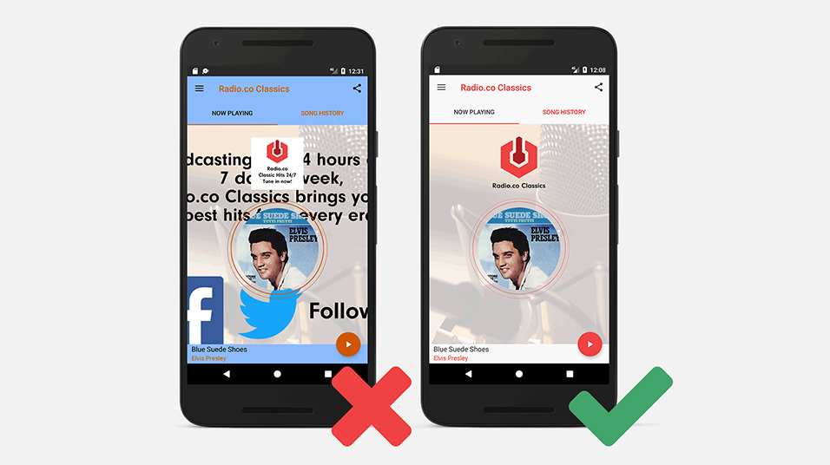
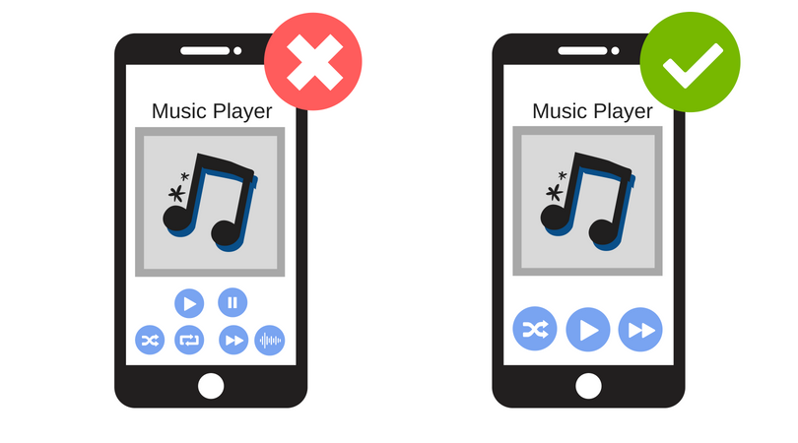
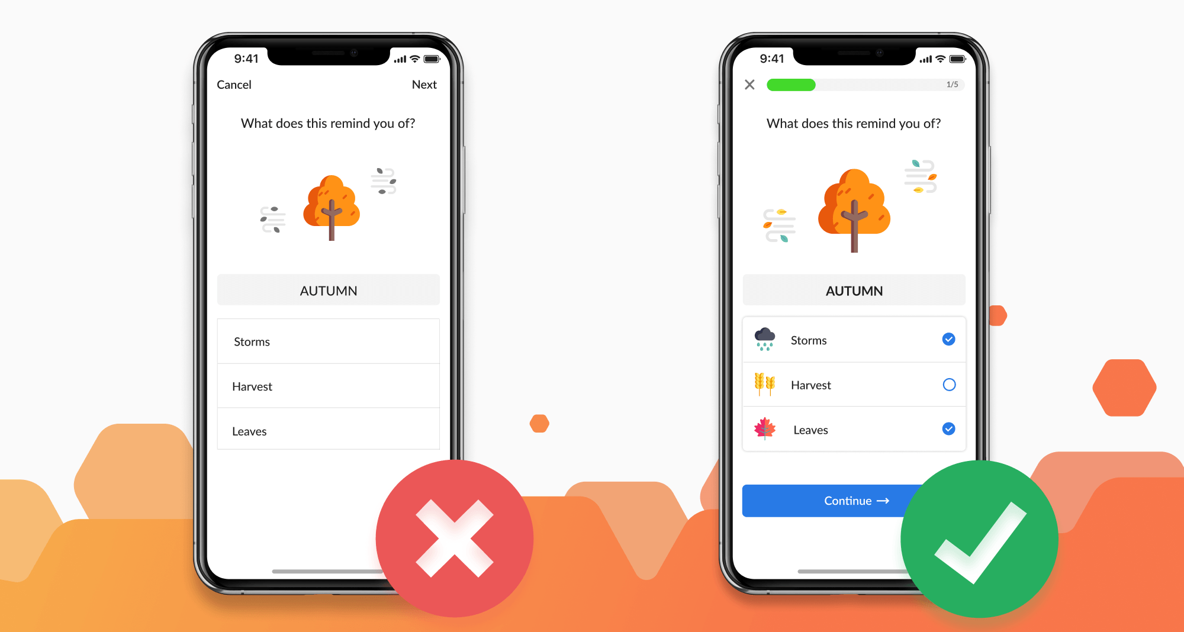
Example 2

Slide 9
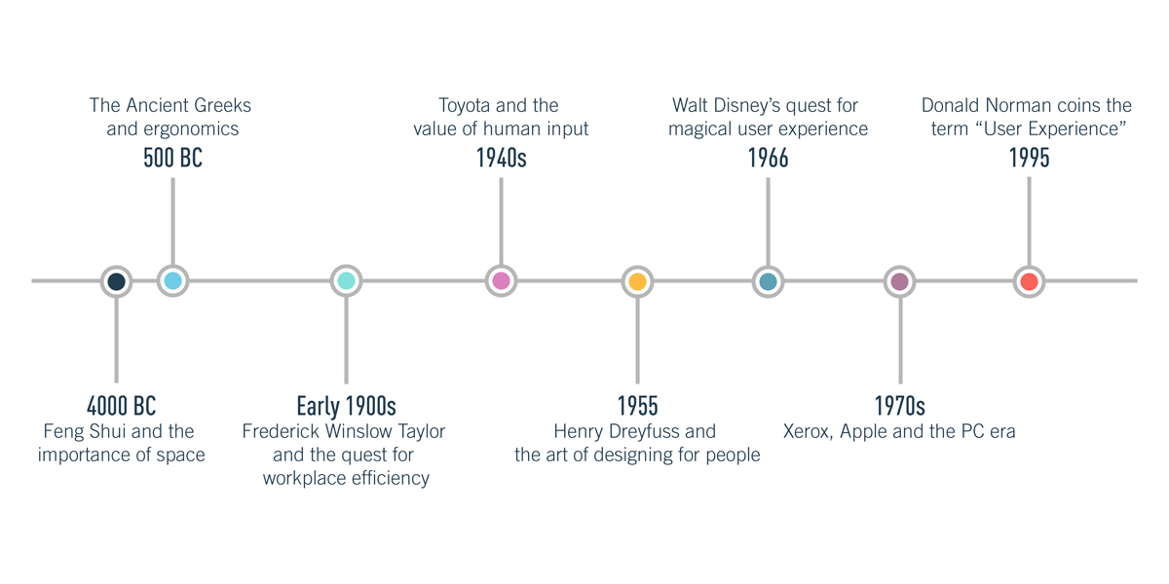
2. The History Of UX Design

Slide 10
Cont. The History Of UX Design
4000 BC: Feng Shui and the importance of space
focuses on arranging your surroundings in the most optimal, or user-friendly way to makes it easy for the inhabitant to navigate the room.
500 BC: The Ancient Greeks and ergonomics
as early as the 5th century BC, Greek civilizations designed their tools and workplaces based on ergonomic principles.

Slide 11
Cont. The History Of UX Design
Early 1900s: Frederick Winslow Taylor and the quest for workplace efficiency
Frederick Winslow Taylor, a mechanical engineer and pioneer of Taylorism—otherwise known as Scientific Management. On a mission to make human labor more efficient, Taylor conducted extensive research into the interactions between workers and their tools.
In 1911, he wrote “The Principles of Scientific Management”.

Slide 12
Cont. The History Of UX Design
1940s: Toyota and the value of human input
Toyota developed their famous human-centered production system. Unlike Taylorism, the Toyota Production System was based upon respect for people, and much attention was paid to creating the optimal working environment.
1955: Henry Dreyfuss and the art of designing for people
In 1955, he wrote Designing for People, which pretty much explains UX design in a nutshell: “When the point of contact between the product and the people becomes a point of friction, then the [designer] has failed. On the other hand, if people are made safer, more comfortable, more eager to purchase, more efficient—or just plain happier—by contact with the product, then the designer has succeeded.”

Slide 13
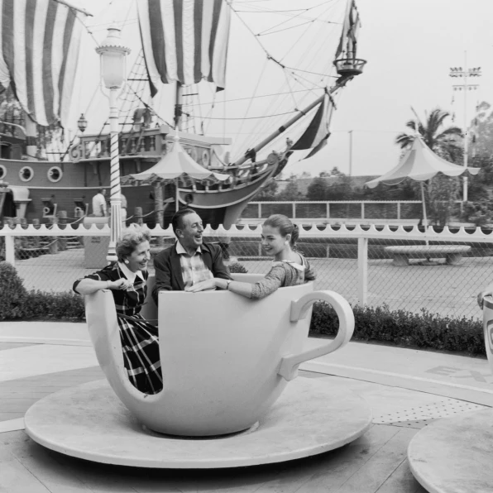
Cont. The History Of UX Design
1966: Walt Disney—the first UX designer?
Engineers aren’t the only ones who had a part to play in the history of UX, but Walt Disney is one of the first UX designers in history.
Joseph Dickerson outlines Walt Disney’s guiding principles for his team of engineers—or Imagineers, as he called them: know your audience, wear your guest’s shoes, communicate with color, shape, form and texture…
Disney envisioned a place where “the latest technology can be used to improve the lives of people” - a vision that today’s UX designers no doubt share.

Slide 14
Cont. The History Of UX Design
1970s: Xerox, Apple and the PC era
The 1970s kicked off the era of personal computers, with psychologists and engineers working together to focus on the user experience. Many of the most influential developments came out of Xerox’s PARC research center, such as the graphical user interface and the mouse.
And now over to Apple. In 1984, the original Macintosh was released—Apple’s first mass-market PC featuring a graphical user interface, built-in screen and mouse. Since then, Apple has been a true innovator of user experience, from the first iPod in 2001 to the iPhone in 2007.

Slide 15
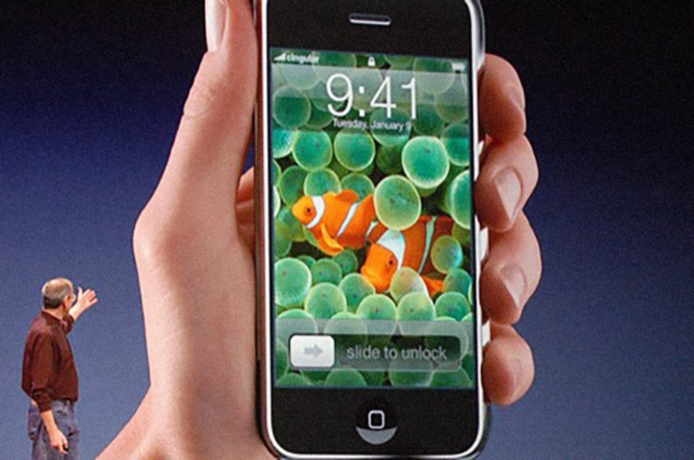
Cont. The History Of UX Design
1995: Donald Norman gives UX Design a name
By this point, user experience design was very much happening—it just didn’t have a label yet.
Donald Norman, a cognitive scientist, joined the team at Apple in the early 90s as their User Experience Architect—making him the first person to have UX in his job title.
He came up with the term “user experience design” as a way of encompassing all that UX is. As he explains, “I invented the term because I thought human interface and usability were too narrow: I wanted to cover all aspects of the person’s experience with a system, including industrial design, graphics, the interface, the physical interaction, and the manual.”
In 1988, Norman published The Psychology of Everyday Things (later updated to The Design of Everyday Things)—which continues to be a UX design staple to this day.

Slide 16
Cont. The History Of UX Design
2018 and beyond: History in the making
UX design is constantly evolving, and the fascinating journey continues. From Artificial Intelligence to voice technology, from Virtual Reality to design without interface—today’s UX designers face new challenges every day. Whatever the future holds, we’re sure it’ll be just as exciting as the history that precedes it.

Slide 17
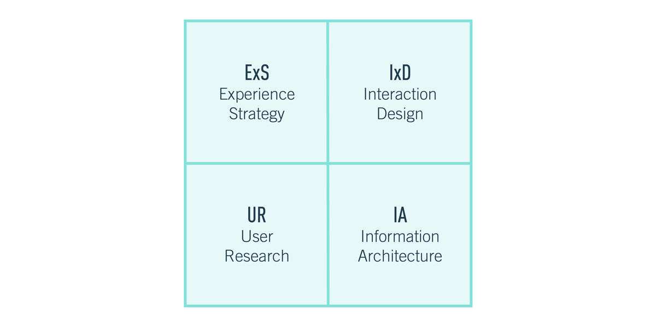
3. UX Design Disciplines: The Quadrant Model
UX is a broad umbrella term that can be divided up into four main disciplines:

Slide 18
Cont. UX Design Disciplines: The Quadrant Model
Experience Strategy (ExS)
UX design is not just about the end user; it also brings huge value to the business providing the product or service. Experience strategy is all about devising a holistic business strategy, incorporating both the customer’s needs and those of the company.
Interaction Design (IxD)
Interaction design looks at how the user interacts with a system, considering all interactive elements such as buttons, page transitions and animations. Interaction designers seek to create intuitive designs that allow the user to effortlessly complete core tasks and actions.

Slide 19
Cont. UX Design Disciplines: The Quadrant Model
User Research (UR)
UX design is all about identifying a problem and designing the solution. This requires extensive research and feedback from existing or potential customers. During the research phase, UX designers will launch surveys, conduct interviews and usability testing, and create user personas in order to understand the end user’s needs and objectives.
Information Architecture (IA)
Information architecture is the practice of organizing information and content in a meaningful and accessible way. This is crucial in helping the user to navigate their way around a product. To determine the IA of any given product, information architects consider the relationship between different sets of content.

Slide 20
UX Design Tools
UX designers rely on a number of different tools as they go about their work.
At the research and inspiration stage, they will use survey and polling tools as well as video chat software to interview users and gather as much information as possible.
Specific programs for wireframing, prototyping and usability testing, with Balsamiq, InVision and UsabilityHub among the most popular in the industry.
In addition to design-specific programs, designers also use communication and project management tools to keep track of their work at all times.

Slide 21
What Kinds Of Projects Do UX Designers Work On?
Website, App And Software Design
Voice Design
Virtual Reality (VR) and Augmented Reality (AR)
Service Design

Slide 22
5. The Value of UX Design
The value of UX design is immense; not only for the end user, but also for the business or brand behind the user experience.
From a user perspective, good UX design ultimately enables us to go about our daily lives as effortlessly as possible.

Slide 23
Universal Design (UD)
As motivational speaker Molly Burke explains, universal design is the practice of “designing and building everything to be accessed, enjoyed and understood to its fullest extent, by everyone, regardless of their size, their age, their ability, or their perceived ability.”

Slide 24
Universal design seven key principles:
Equitable use: The design is useful and marketable to people with diverse abilities.
Flexibility in use: The design accommodates a wide range of individual preferences and abilities.
Simple and intuitive use: Use of the design is easy to understand, regardless of the user’s experience, knowledge, language skills, or current concentration level.
Perceptible information: The design communicates necessary information effectively to the user, regardless of ambient conditions or the user’s sensory abilities.

Slide 25
Cont. Universal design seven key principles:
Tolerance for error: The design minimizes hazards and the adverse consequences of accidental or unintended actions.
Low physical effort: The design can be used efficiently and comfortably and with a minimum of fatigue.
Size and space for approach and use: Appropriate size and space is provided for approach, reach, manipulation, and use regardless of user’s body size, posture, or mobility.

Slide 26
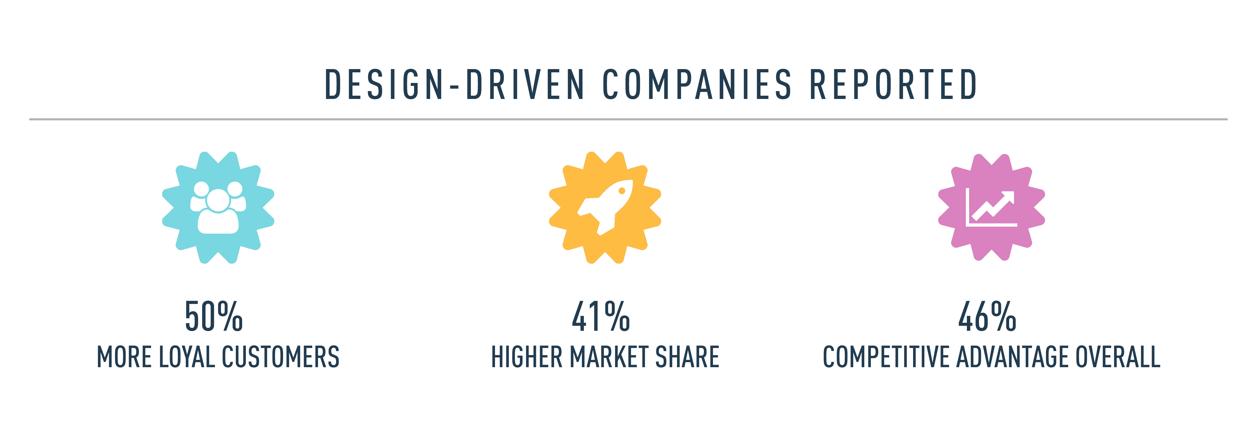
Good Design Is Good Business
From a business perspective, designing first-class user experiences is absolutely key to ensuring customer satisfaction and building brand loyalty. Only if a product or service is hassle-free and enjoyable will the user want to return.
“Good design is good business.”
— Thomas Watson Jr., CEO, IBM

Slide 27
6. How To Become A UX Designer
An interest in technology and how humans interact with it
Strong problem-solving skills
Strong communication skills and ability to collaborate
An ability to think both creatively and analytically
A strong gift for empathy and a user-first mindset

Slide 28
The End

